Slide 1



Shaping and characterization of microbial electrosynthesis communities
ANR-22-PEBB-0005

Slide 2

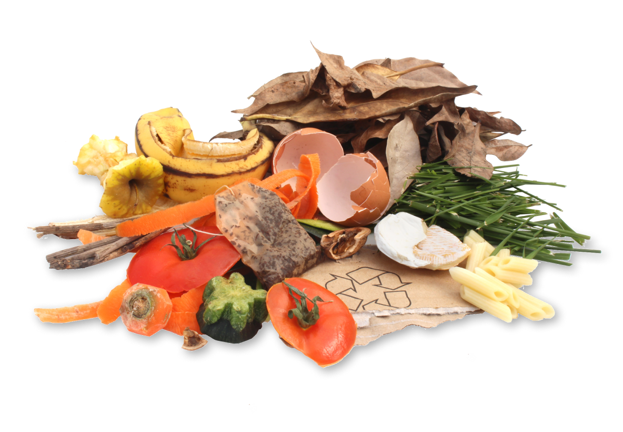
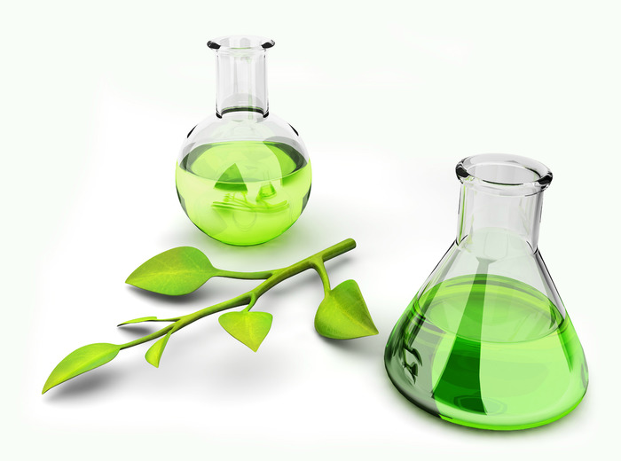
Presentation of the ElectroMIC project ANR-22-PEBB-0005
"Optimization of the metabolic network of an electrochemically assisted microbial community for the organic waste biorefinery" (2023-2027)
Biowaste
?
ENVIRONMENTAL BIOREFINERY TECHNOLOGIES
Production of high value-added molecules
Notes:
The aim of ElectroMIC is to use biowaste to produce high value-added molecules, in the context of an environmental biorefinery.

Slide 3
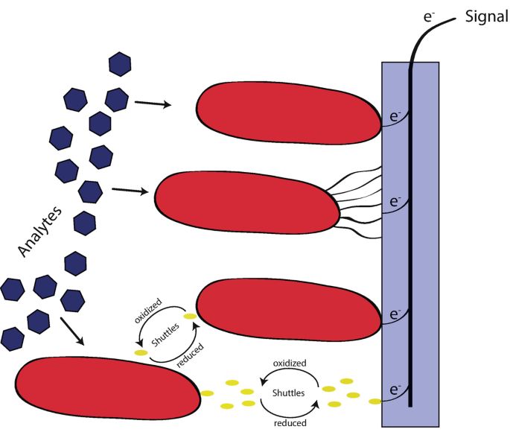
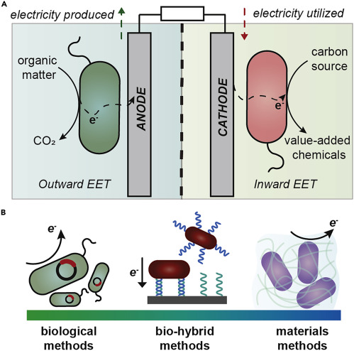
Presentation of the ElectroMIC project ANR-22-PEBB-0005
"Optimization of the metabolic network of an electrochemically assisted microbial community for the organic waste biorefinery" (2023-2027)
Source: Catania, et al., 2021
Notes:
Through electromicrobial systems, which are compartmentalized systems in which electrodes are immersed. They recover electrical energy from the oxidation of organic matter contained in biowaste in a first anodic compartment, where the anode is an electrode acting as an e-acceptor for microorganisms, for the reduction of carbon dioxide into volatile fatty acid molecules by complex microbial communities in a cathode acting as an electron donor.
they work thanks to the specific capacity of certain microorganisms: electroactivity. This is the ability to exchange electrons outside the cell with solid supports, such as electrodes.

Slide 4
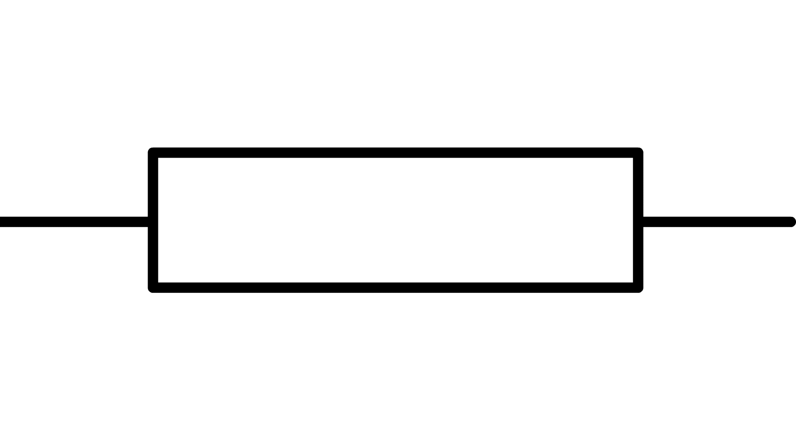
Presentation of the ElectroMIC project ANR-22-PEBB-0005
"Optimization of the metabolic network of an electrochemically assisted microbial community for the organic waste biorefinery" (2023-2027)
Why use microbial saline electrolyzers?
Electrolyte non-salin
Electrolyte salin
-
-
-
+
+
+
+
-
+
-
Notes:
These systems consume very little energy, but the limit to scaling up these technologies is the power required to operate them. The resistance of the system depends largely on the conductivity of the electrolyte. Reducing system resistance to reduce power consumption
And resistance depends largely on electrolyte conductivity. But there are very few reports in the literature of electrolyzers operating under saline conditions.

Slide 5
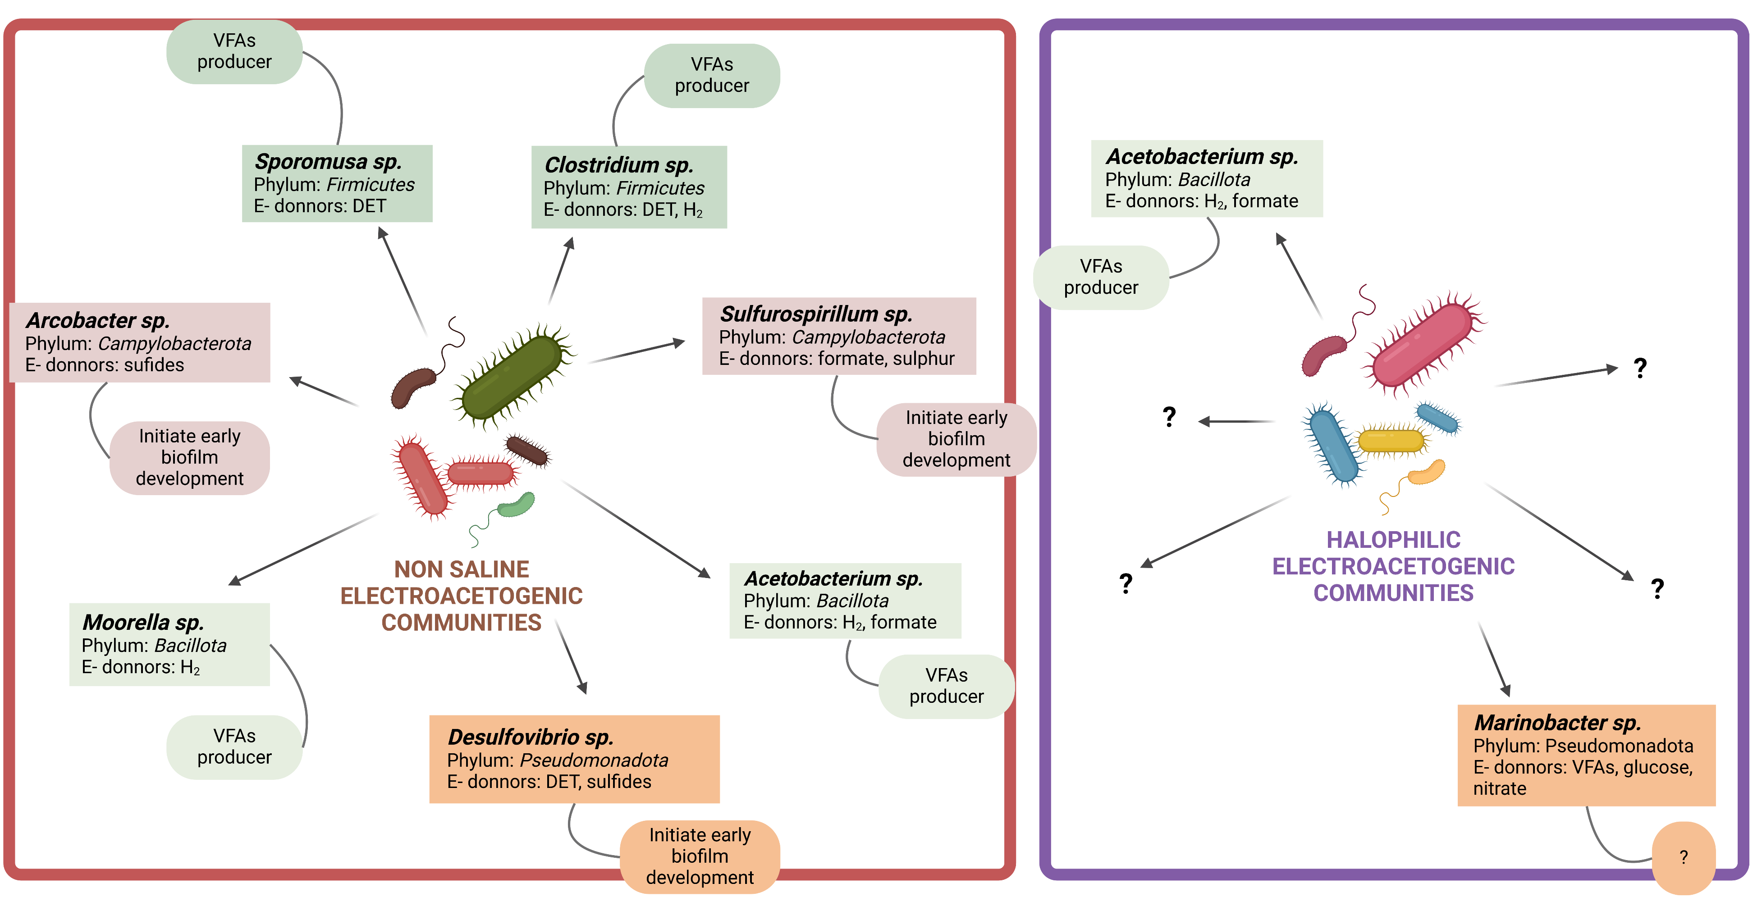
Characterization of microbial communities at the cathode
Source: Created from Mills et al., 2022.
Notes:
The communities that produce VFAs at the cathode, the halophilic electroacetogens, have therefore been very poorly characterized, compared with the non-salts, whose diversity and role are partly known.
But there are very few reports in the literature of electrolyzers operating under saline conditions.

Slide 6
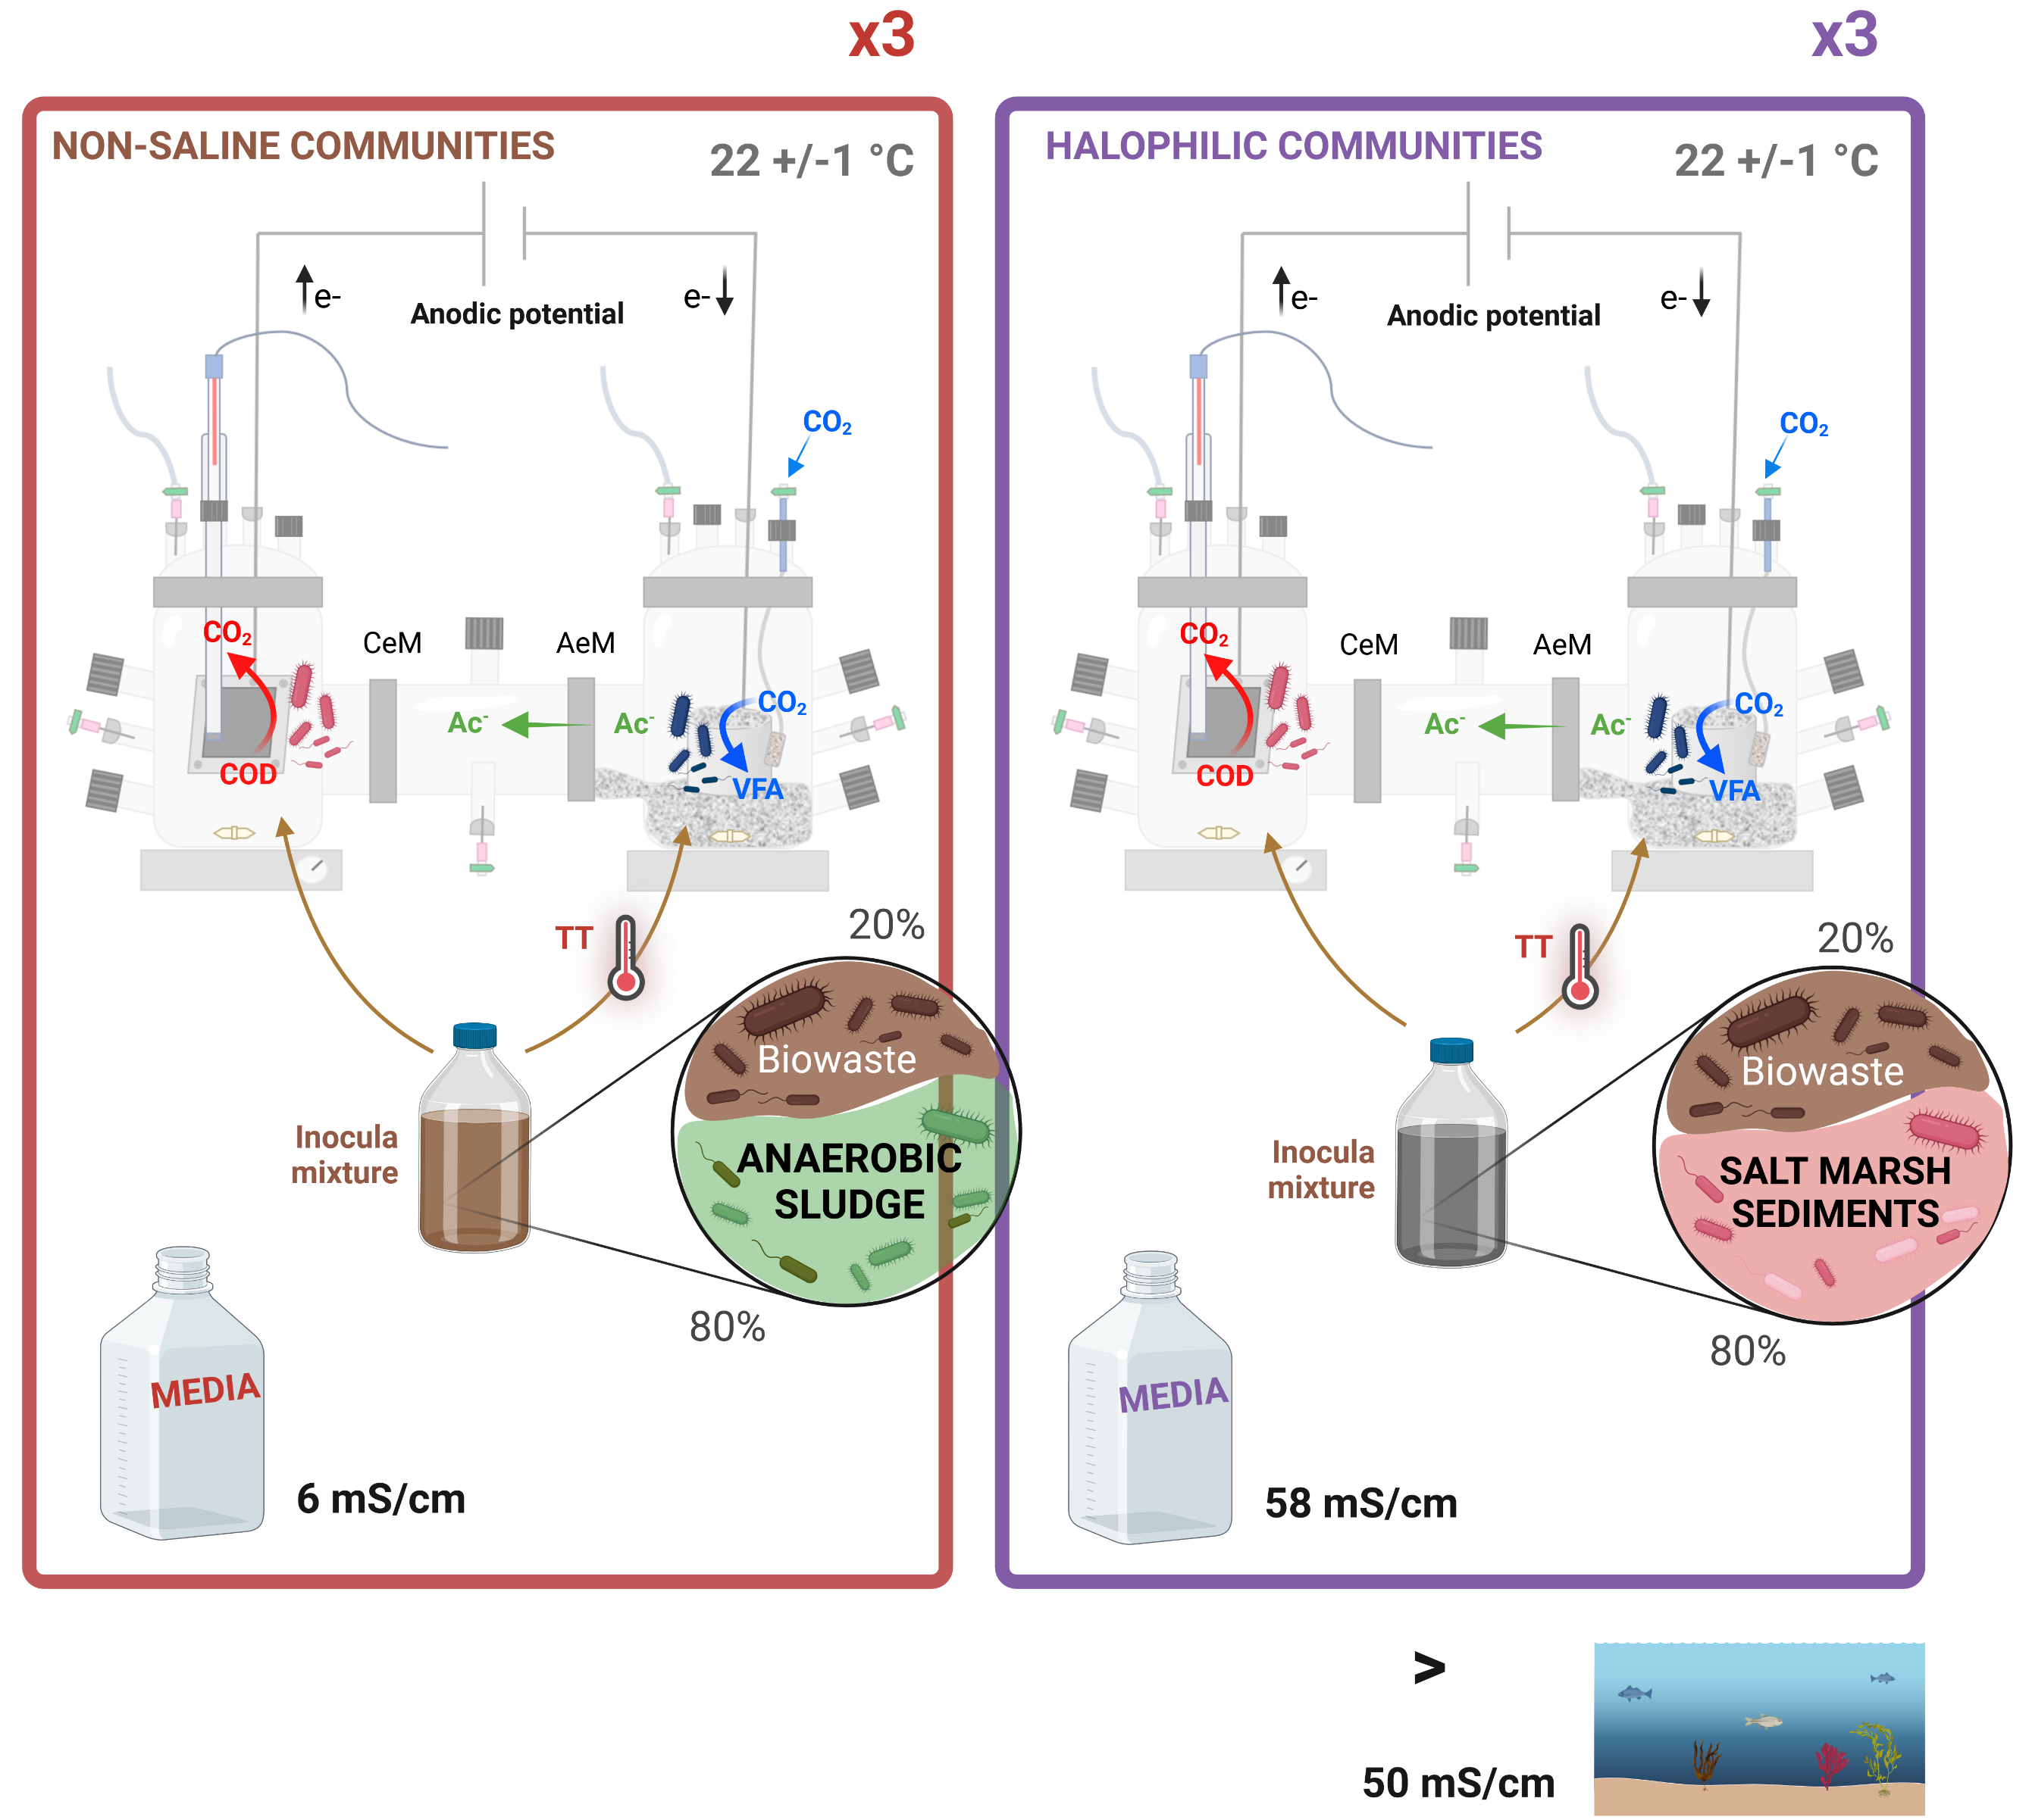
Experimental strategy
Notes:
work in parallel with saline and non-saline communities

Slide 7
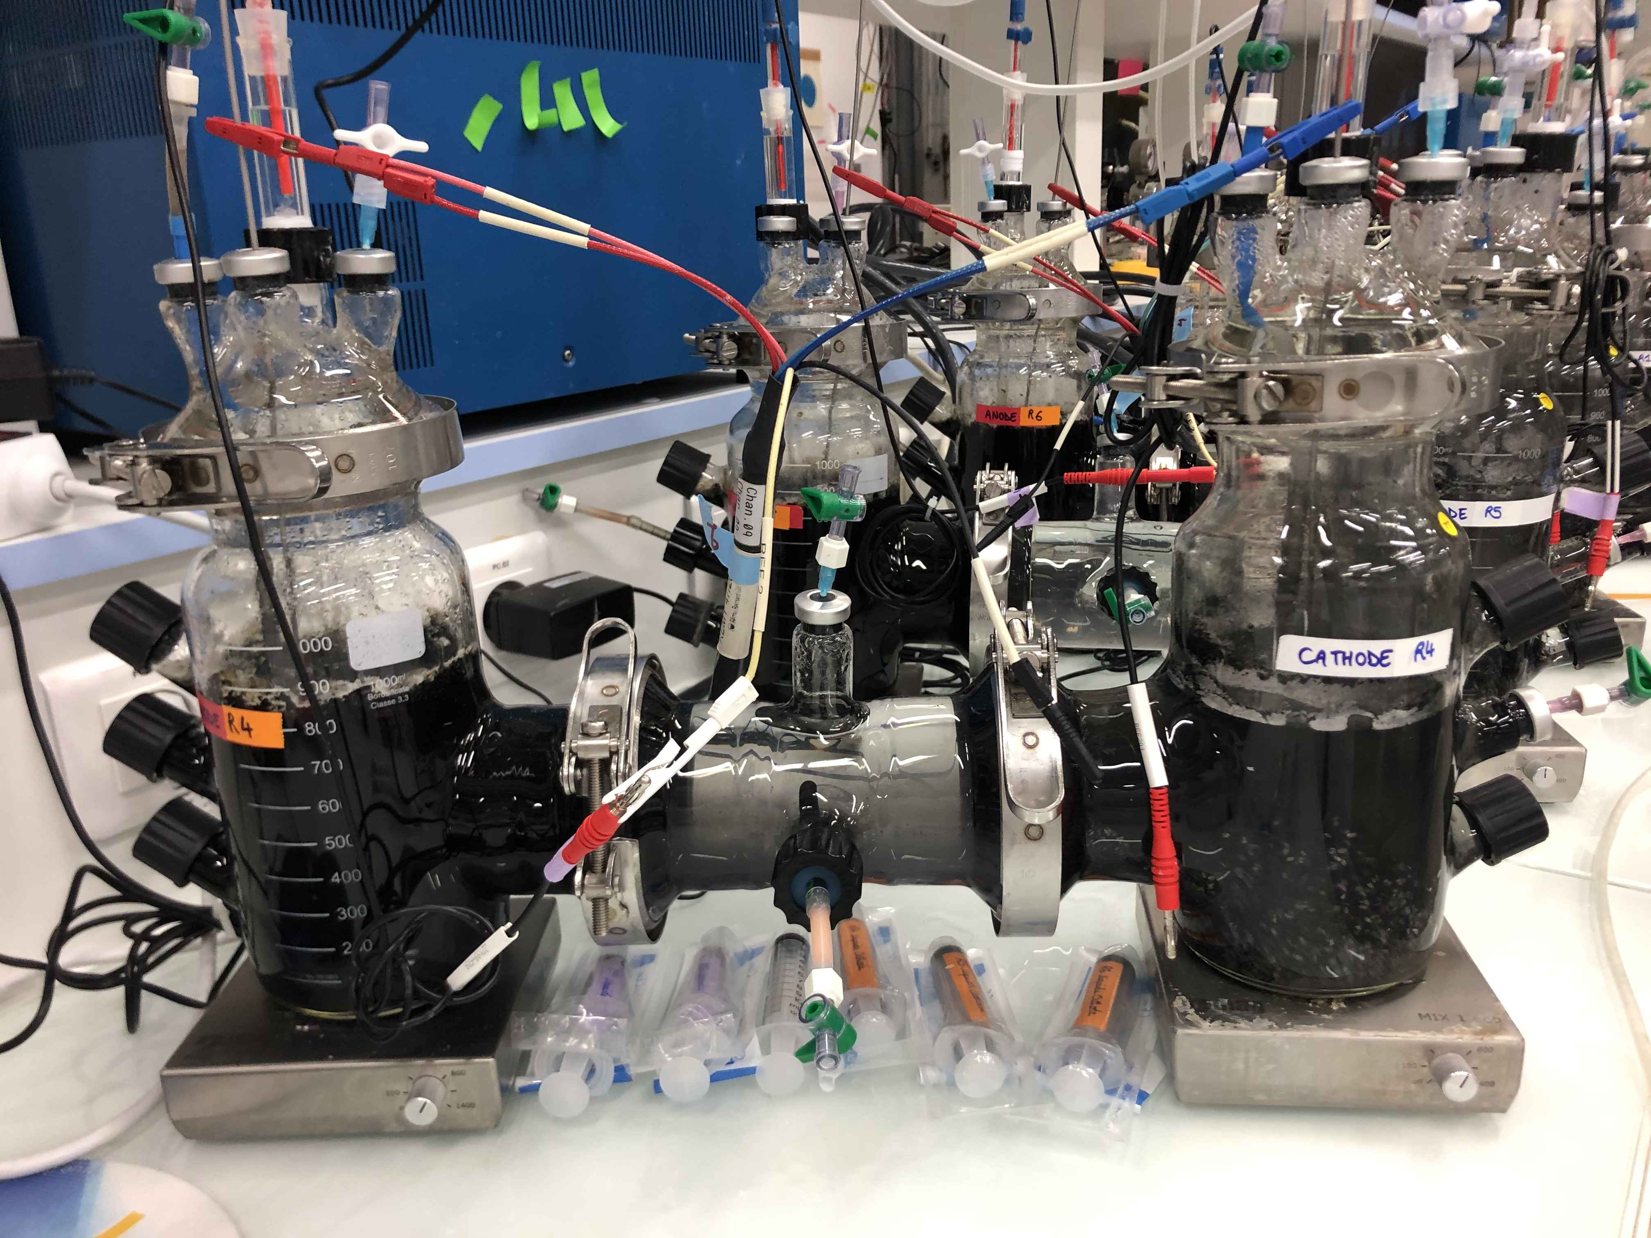
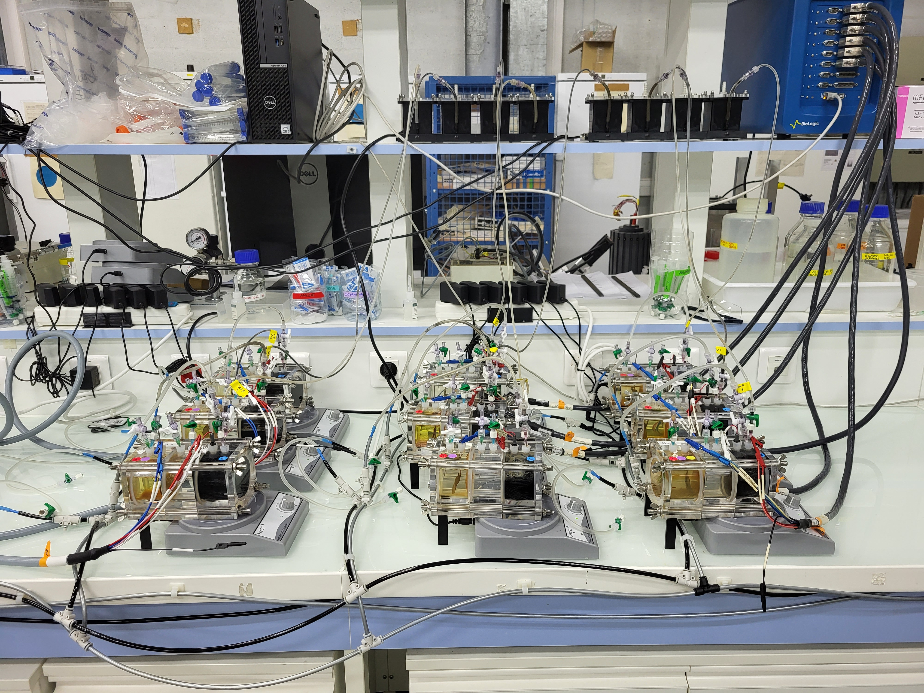
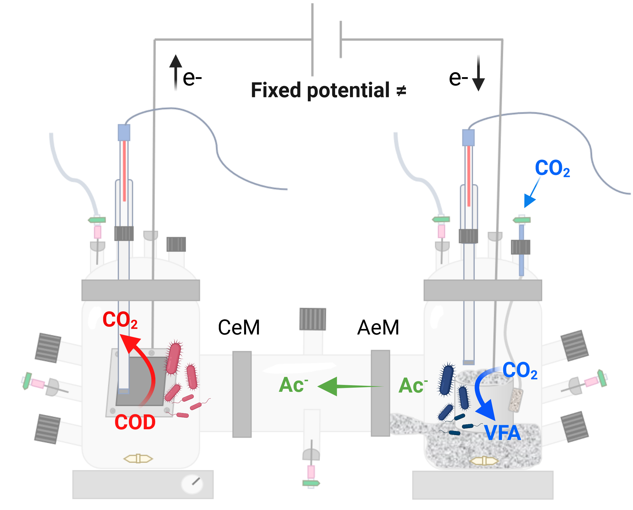
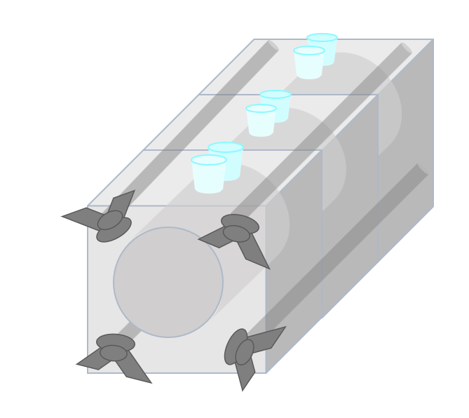
Experimental set-up
H-reactors (1.5 L per compartment):
Laborxing reactors (118 mL per compartment):

Slide 8
Data samples
H-reactors:
Laborxing reactors:
Notes:
various samples were sequenced by metagenomic shotgun sequencing

Slide 9
Questions about the anodic community: Electrogenesis and Microbial Interactions | Questions about the cathodic community: Homoacetogenesis and CO2 Reduction Pathways
Besides Geobacter, what other electrogenic microorganisms are present in the system? Are there competitors of Geobacter for electron transfer to the anode? What are the simple substrates that can generate current at the anode? Can the Geobacter strains present in our anode use alternative carbon sources other than acetate? Are there other electrogenic microorganisms capable of using VFAs as electron donors? How are the microbial populations distributed across the three trophic levels: hydrolytic, fermentative, and electrogenic? What is the affiliation of the dominant microbial populations with these three trophic levels? How do hydrolytic and fermentative populations contribute to electrogenesis by providing substrates for electrogens? Are there specific microbial candidates for the production of exopolymers that contribute to biofilm formation on the anode? What are the potential syntrophic interactions among the microbial populations that enhance current production? | Which homoacetogenic microorganisms are responsible for acetate production from CO₂ in the system? What metabolic pathways are involved in acetate production from CO₂? And for the others VFAs? Can the microbial community produce all volatile fatty acids (VFAs) from CO₂, and if so, through which pathways? What is the role of H₂ in electron transfer and CO₂ reduction? Is there evidence of direct or indirect electron transfer at the cathode? Does CO₂ reduction occur via hydrogen-mediated pathways, or are there alternative indirect mechanisms? What biochemical evidence supports CO₂ reduction into formate at the cathode? What are the potential proteins secreted by the microbial community that attach to the cathode and catalyze CO₂ reduction into formate? What are the potential metabolic routes for direct CO₂ reduction into acetate without an intermediate like formate? How do cathodic microbial populations interact metabolically to facilitate CO₂ reduction and homoacetogenesis?

Slide 10

Questions about the anodic community: Electrogenesis and Microbial Interactions
Besides Geobacter, what other electrogenic microorganisms are present in the system? Are there competitors of Geobacter for electron transfer to the anode? What are the simple substrates that can generate current at the anode? Can the Geobacter strains present in our anode use alternative carbon sources other than acetate? Are there other electrogenic microorganisms capable of using VFAs as electron donors? How are the microbial populations distributed across the three trophic levels: hydrolytic, fermentative, and electrogenic? What is the affiliation of the dominant microbial populations with these three trophic levels? How do hydrolytic and fermentative populations contribute to electrogenesis by providing substrates for electrogens? Are there specific microbial candidates for the production of exopolymers that contribute to biofilm formation on the anode? What are the potential syntrophic interactions among the microbial populations that enhance current production?
Notes:
The carbon source for the microorganisms at the anode is a complex matrix: biowaste hydrolysates containing the products of hydrolysis after 7 days of fermentation: mainly VFAs.

Slide 11
Questions about the cathodic community: Homoacetogenesis and CO2 Reduction Pathways
Which homoacetogenic microorganisms are responsible for acetate production from CO₂ in the system? What metabolic pathways are involved in acetate production from CO₂? And for the others VFAs? Can the microbial community produce all volatile fatty acids (VFAs) from CO₂, and if so, through which pathways? What is the role of H₂ in electron transfer and CO₂ reduction? Is there evidence of direct or indirect electron transfer at the cathode? Does CO₂ reduction occur via hydrogen-mediated pathways, or are there alternative indirect mechanisms? What biochemical evidence supports CO₂ reduction into formate at the cathode? What are the potential proteins secreted by the microbial community that attach to the cathode and catalyze CO₂ reduction into formate? What are the potential metabolic routes for direct CO₂ reduction into acetate without an intermediate like formate? How do cathodic microbial populations interact metabolically to facilitate CO₂ reduction and homoacetogenesis? How propionate is produced through acetate?
Notes:
Wood Ljungdahl

